Slide 1

Analytics Portfolio
From data collection to customer intelligence
Joseph Kennedy | Senior Data Analyst
October 2026

Slide 2
Business at a Glance
Fetch is a multi-seller e-commerce marketplace connecting thousands of independent sellers to consumers across the US. The business has scaled rapidly but lacks a unified analytics function. This project builds the measurement layer from scratch: warehouse, dashboards, segmentation and predictive models.
$9.4M
$159.70
$1.30
$45.60
5.9%
4.1
total
per order
paid channels
blended
of delivered orders
out of 5.0
Revenue
Avg Order Value
Cost per Click
Customer Acq. Cost
Return Rate
Avg Review Score
Revenue grew from $46K/month (Oct 2016) to $985K/month steady state (Aug 2018), with a $1.15M Black Friday peak
Top 20 product categories account for 85% of revenue; no single category exceeds 9%
SP state concentration risk: 64.6% of all revenue from one state, top 3 states = 81.5%
97% of customers buy once. Repeat purchase rate is 3% vs industry benchmark of 25-40%
6.77% late delivery rate, but late orders are 6.7x more likely to produce a bad review
Stockout revenue at risk estimated at $4.5M (29% of realised revenue)
Fetch
Overview
02

Slide 3
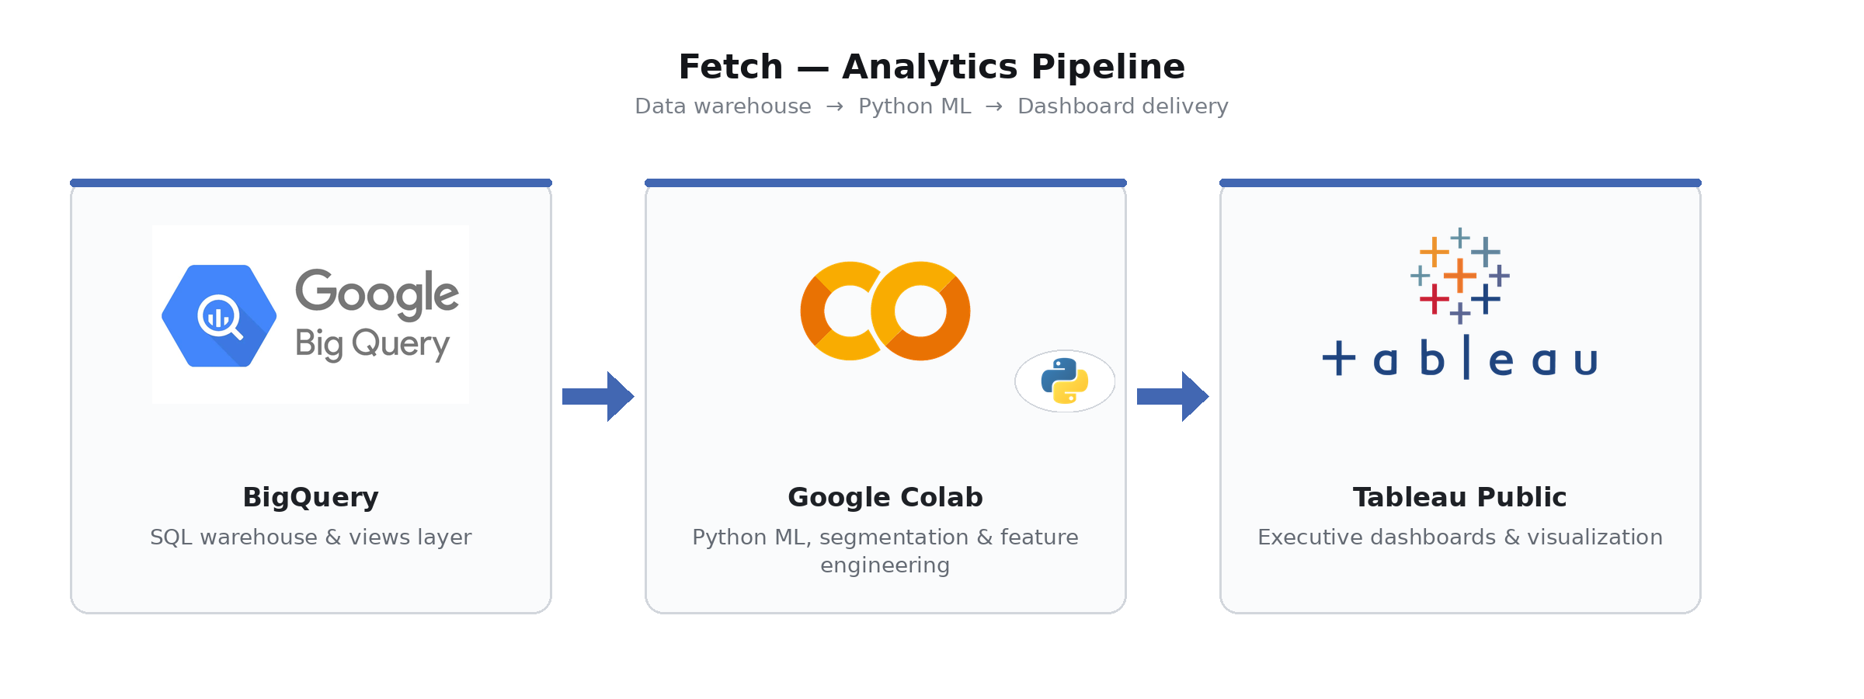
Tech Stack and Data Pipeline
Warehouse
BigQuery hosts 8 dimension and fact tables, 15 analytical views, and the ad-spend join.
Compute
Google Colab runs Python for ad-spend analysis, K-Means segmentation and predictive modelling.
Visualisation
Tableau Public serves 4 department dashboards with live extracts.
Data quality
Three documented issues found and resolved during exploration (review duplicates, week alignment, delivery timestamp batching).
Fetch
Data Engineering
03

Slide 4
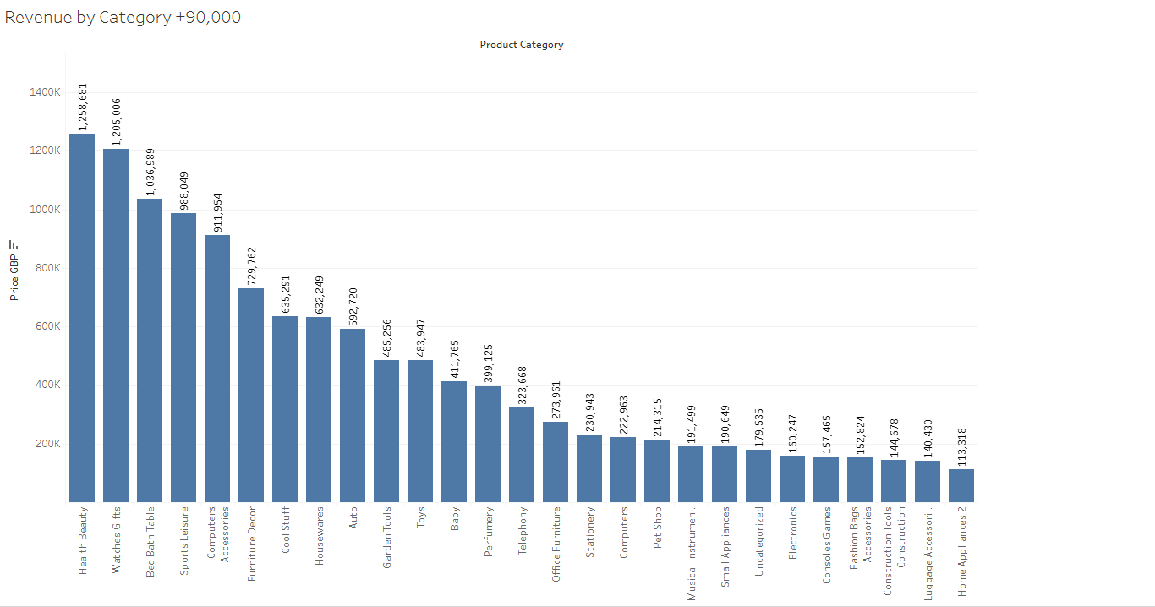
Revenue Performance
Key findings
Revenue grew from $46K/month (Oct 2016) to $985K/month steady state, with a $1.15M Black Friday peak in Nov 2017
Top 20 categories account for 85% of revenue. Health Beauty leads at 9%, with no single-category dependency
AOV flat at $155-170 across all 7 channels, so channel strategy is a volume and cost decision, not a quality one
SP state concentration risk: 64.6% of revenue from one state. Top 3 states = 81.5%
Dec 2016 anomaly: 1 order only, likely a marketing pause or platform outage
Top seller accounts for 1.6% of revenue; top 20 = 22%. No seller concentration risk across 3,000+ sellers
Seller strategy split: volume plays (~$80 AOV, 1,800+ orders) vs high-ticket (~$660 AOV, few hundred orders)
Fetch
Sales
04

Slide 5
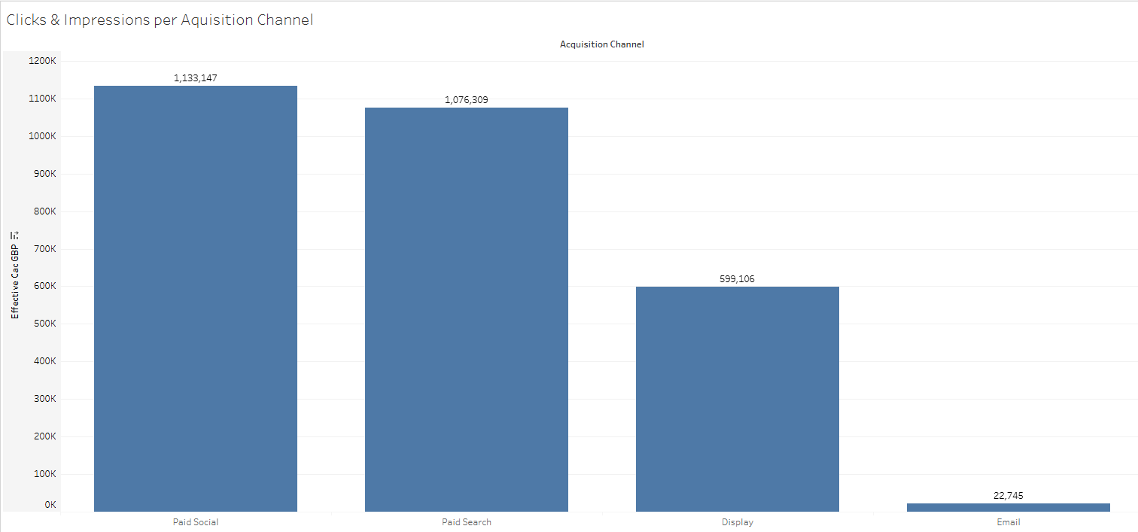
Marketing Efficiency
Channel efficiency
Email CAC: $2.20 (lowest cost channel, but small volume)
Paid Search CAC: $43.83 (primary volume driver)
Paid Social CAC: $57.85 (mid-tier efficiency)
Display CAC: $76.47 (highest cost, weakest return)
CTR (2.0%) and conversion rate (2.5%) are identical across all paid channels: CAC differences are driven entirely by CPM, not funnel quality
The strategic lever is CPM negotiation or shifting budget toward Email, which has 20x better efficiency than Display
Diagnostic funnel
Channel | CTR % | Conv % | CPM | CAC
Email | 7.5 | 33.3 | $55 | $2.20
Paid Search | 2.0 | 2.5 | $22 | $43.83
Paid Social | 2.0 | 2.5 | $29 | $57.85
Display | 2.0 | 2.5 | $38 | $76.47
Fetch
Marketing
05

Slide 6
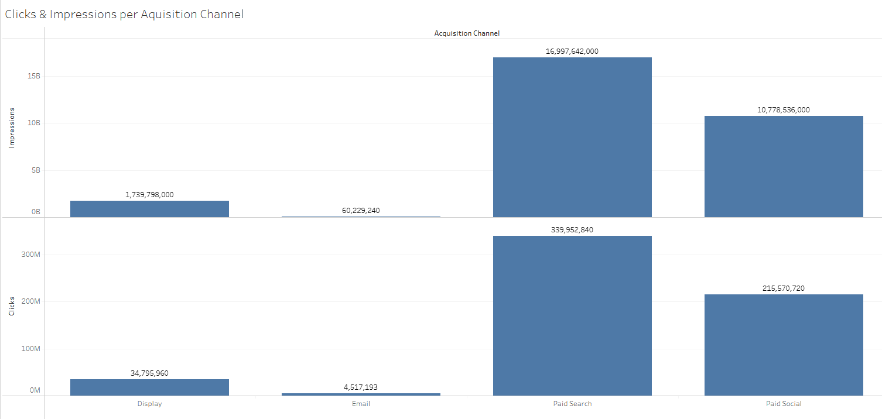
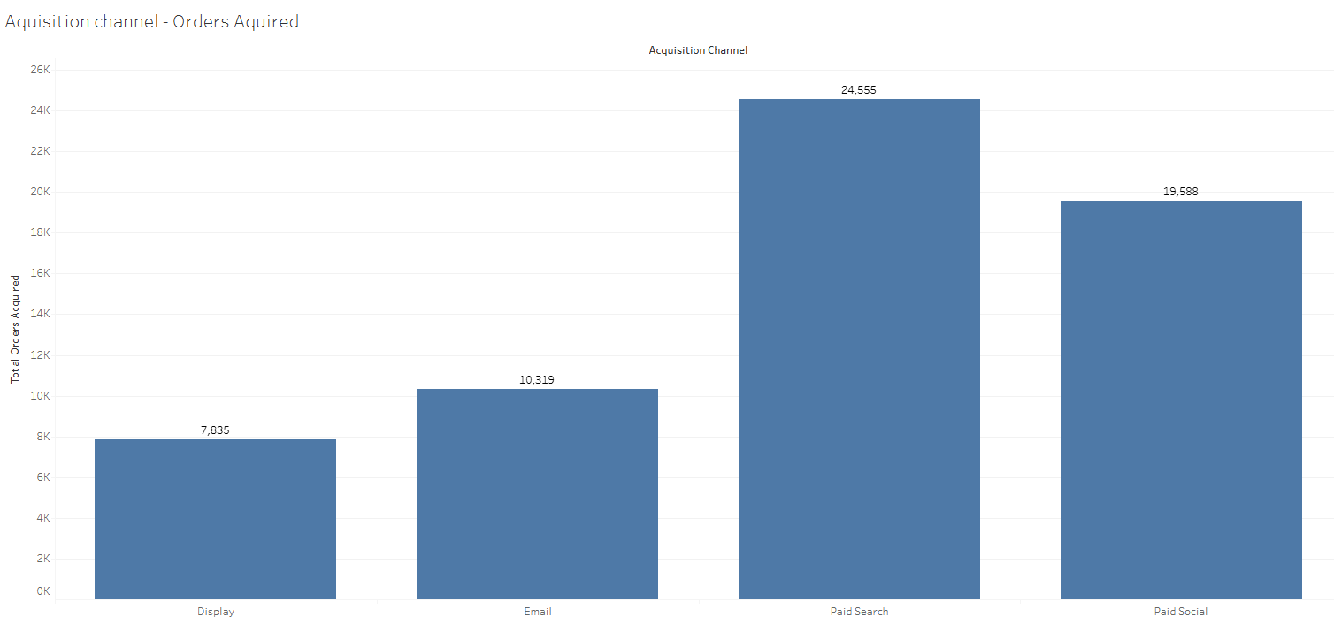
Channel Attribution
Organic overtook Paid Search as the top channel from April 2018, a sign of brand maturity.
Direct traffic grew 40x over the period, acting as a proxy for brand recognition. CTR (2.0%) and conversion rate (2.5%) are identical across paid channels, which means CAC differences are driven entirely by CPM, not funnel quality. The strategic lever is CPM negotiation or shifting budget toward lower-cost channels like Email ($2.20 CAC).
Fetch
Marketing
06

Slide 7
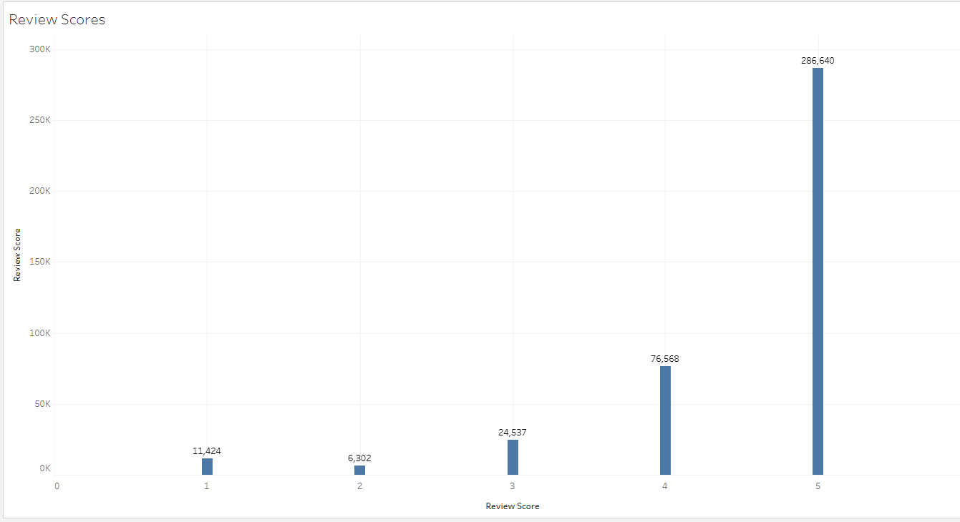
Operations and Delivery
Delivery and CSAT
Median delivery: 10 days. Mean 12.5 (right-skewed). P90 = 23 days, meaning 10% of customers wait 3+ weeks
On-time rate: 93.2%. Within 2 points of Amazon Prime benchmarks, without centralised logistics
Late orders score 2.27 avg review (vs 4.29 on-time). 62.4% of late orders produce a bad review, a 6.7x multiplier
Late delivery drives 28% of all bad reviews from only 6.77% of orders. Cutting late rate by 50% eliminates 14% of all negative reviews
NPS proxy: +34.85. 57.8% five-star, 11.5% one-star. The 1-star bucket is 3.6x the 2-star bucket: customers polarise rather than settle in the middle
Data quality note: 14 of top 20 longest deliveries timestamped in a single 4-hour batch window (reconciliation artefact, not real wait times)
Fetch
Operations
07

Slide 8
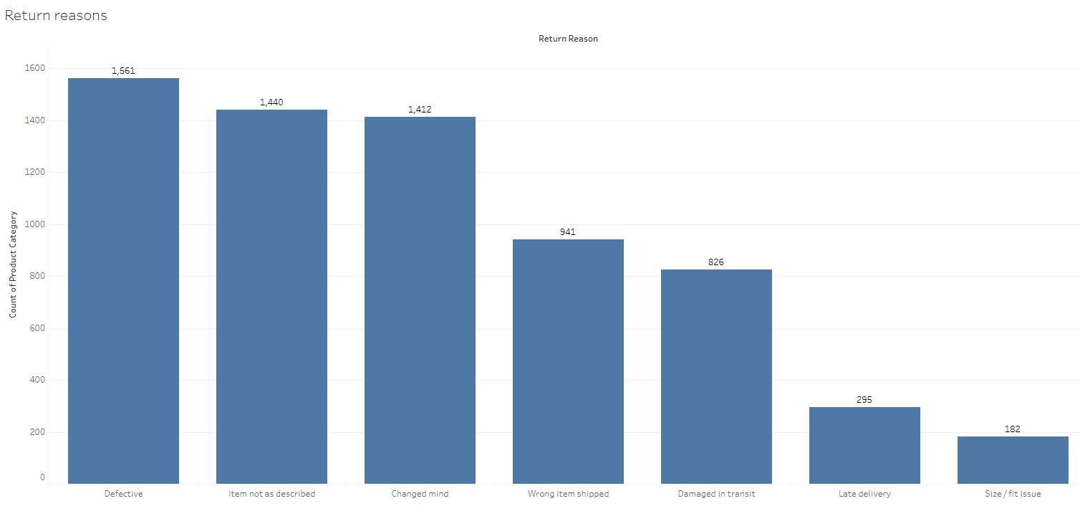
Returns and Seller Quality
59% of returns are seller-preventable
Defective product
23.5%
Item not as described
21.6%
Changed mind
21.2%
Wrong item shipped
14.1%
Damaged in transit
12.4%
Late delivery
4.4%
Size/fit issue
2.7%
Behavioural contradiction: late delivery drives 28% of bad reviews but only 4.4% of returns. Customers keep late items but punish the seller in ratings.
Fetch
Operations
08

Slide 9
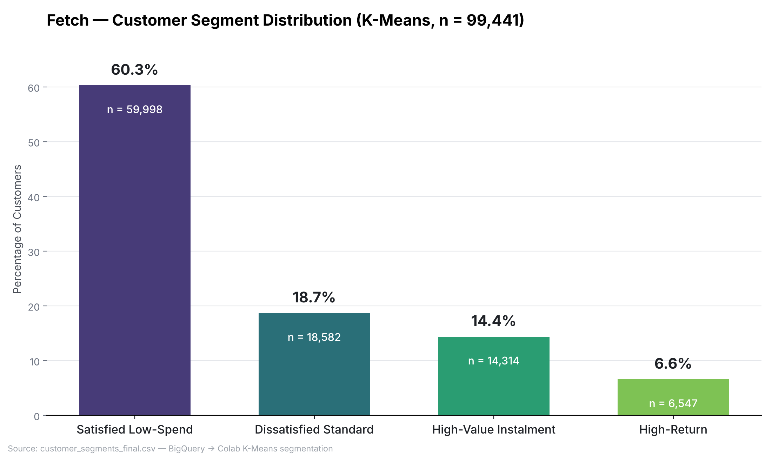
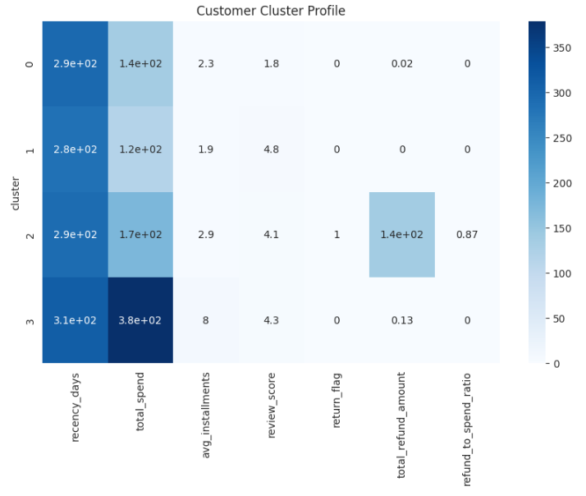
Customer Intelligence: K-Means Segmentation
Satisfied Low-Spend
60.3%
Low frequency, low monetary, high satisfaction. Largest group.
Dissatisfied Standard
18.7%
Average spend, poor reviews. Churn risk.
High-Value Instalment
14.4%
Higher basket size, uses instalment payments.
97% of customers buy once
High-Return
6.6%
Elevated return rates. Operational cost driver.
Repeat purchase rate is 3% vs industry benchmark 25-40%. Growth is entirely acquisition-driven. Moving repeat rate from 3% to 8% would double the revenue base without new acquisition spend.
Fetch
Customer Intelligence
09

Slide 10
Strategic Recommendations
01
02
03
Fix Retention
Reduce Late Deliveries
Address Seller Quality
97% one-and-done rate is the single largest strategic gap. A post-purchase re-engagement flow (email sequences, personalised recommendations via segment data) targeting the Satisfied Low-Spend cluster (60% of customers) has the highest expected return. Moving repeat rate from 3% to 8% doubles the active revenue base.
6.77% of orders arrive late, but those orders are responsible for 28% of all bad reviews. The CSAT multiplier is 6.7x. A 50% reduction in late deliveries eliminates 14% of negative reviews and materially improves the NPS proxy (+34.85 today). Priority: identify the worst-performing seller-state-carrier combinations.
59% of returns are seller-preventable (defective, misdescribed, wrong item). Stockout events represent $4.5M in revenue at risk (~29% of realised revenue). Introduce a seller quality scorecard combining return reason mix, review scores and stockout frequency. Gate marketplace visibility on the score.
3% repeat rate
6.77% late rate
59% seller-fault returns
Target: 8%
Target: 3.5%
Target: 30%
Fetch
Strategy
10

Slide 11
Summary and Next Steps
What we built
Next steps
8 warehouse tables and 15 analytical views in BigQuery
Predictive model: churn probability scoring using segment features and order history
15-query descriptive narrative covering sales, marketing, operations and customer behaviour
CLV estimation per segment to prioritise retention spend
4 Tableau dashboards (Revenue, Marketing, Operations, KPI Overview)
Seller quality scorecard integrating return reasons, reviews and stockout data
Ad-spend efficiency analysis across 4 paid channels with diagnostic funnel
Delivery carrier performance analysis by state to identify worst-case routes
K-Means customer segmentation (4 clusters on RFM features)
Geo-translation layer (US state mapping) for portfolio presentation
3 data quality issues documented and resolved
Fetch is building its analytics capability from the ground up. This is the foundation.
Fetch
Summary
11

